Slide 1
Team EduCaution
06 Med-Fi Prototype
Neha Chetry
Victoria Ding
Ingrid Fan
Isha Kumar

Slide 2
Our Team
Neha C. Victoria D. Ingrid F. Isha K.

Slide 3
Our Solution
The Problem
Leveraging mental health resources is currently laborious yet ineffective, making the prioritization of wellbeing feel burdensome.
A resource navigation tool that is more visually soothing, reflective, and action oriented.

Slide 4
Mission Statement
Value Proposition
Transforming student wellbeing into an effortless, effective, and personalized social experience.
Find personalized resources, and source community support.
Notes:
Value prop feedback: Need more “punchy” words

Slide 5
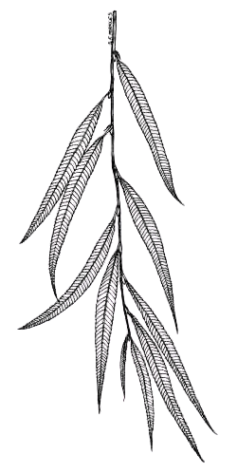
Wello
Come relax with your wellness willow.

Slide 6
Tasks
simple, moderate, and complex

Slide 7
Tasks
Simple
Moderate
Complex
Can the user explore their own willow and the resources recommended?
Can the user input a new journal entry?
Can the user send a voice recording to a friend on the app?

Slide 8
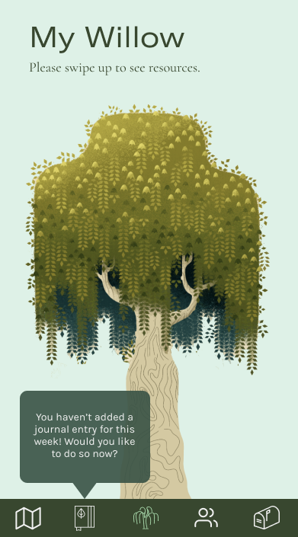
Simple Task
Explore your wellness willow

Slide 9
Simple Task
Explore your wellness willow
Notes:
Feedback: differentiate willows (use accessories like birds, windchimes), make getting to roots more intuitive
Figure out how to put on home screen

Slide 10
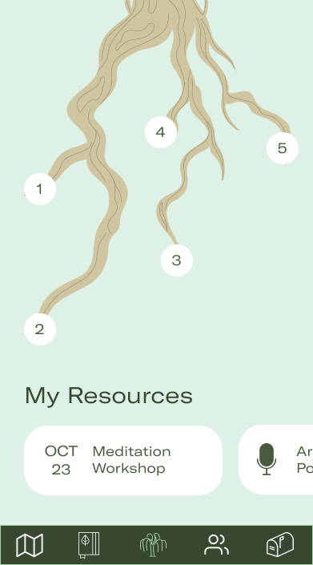
Simple Task
Explore your wellness willow

Slide 11
Simple Task
Explore your wellness willow

Slide 12
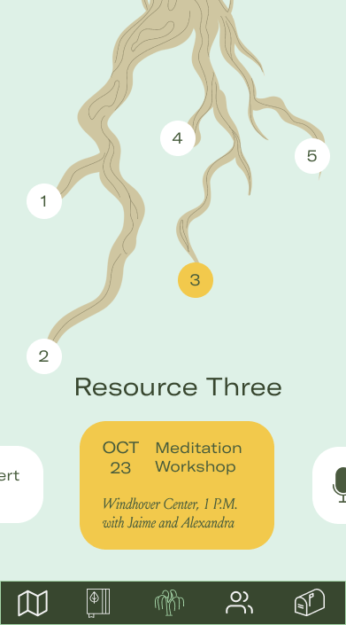
Simple Task
Explore your wellness willow

Slide 14
Moderate Task
Fill out a journal entry

Slide 15
Moderate Task
Fill out a journal entry

Slide 16
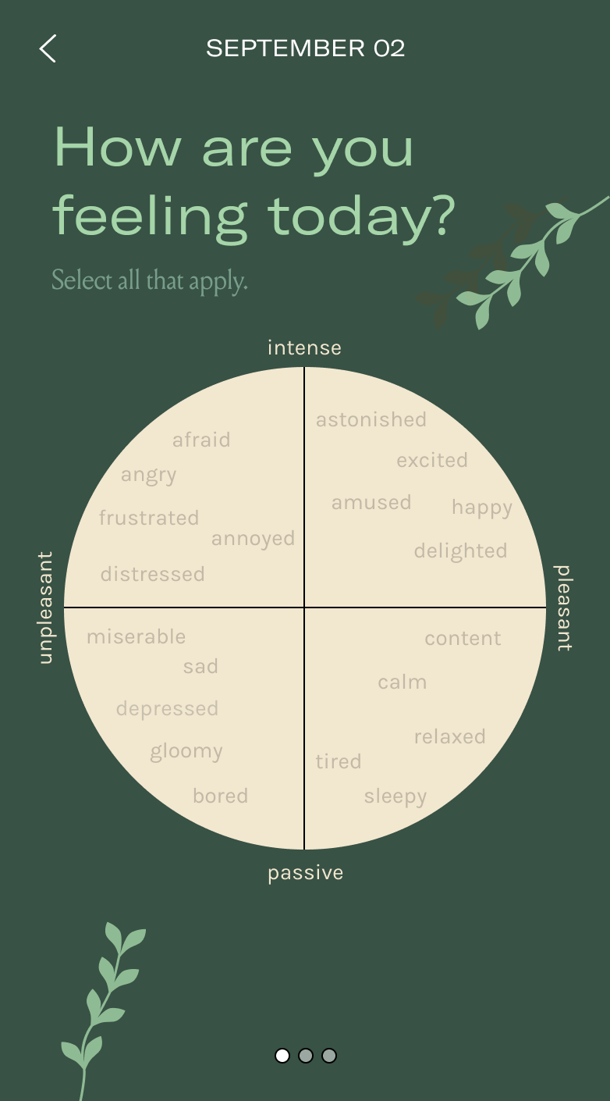
Moderate Task
Fill out a journal entry

Slide 17
Moderate Task
Fill out a journal entry
Notes:
*Feedback*: incorporate pinch and zoom (Landay is less worried about this though)

Slide 18
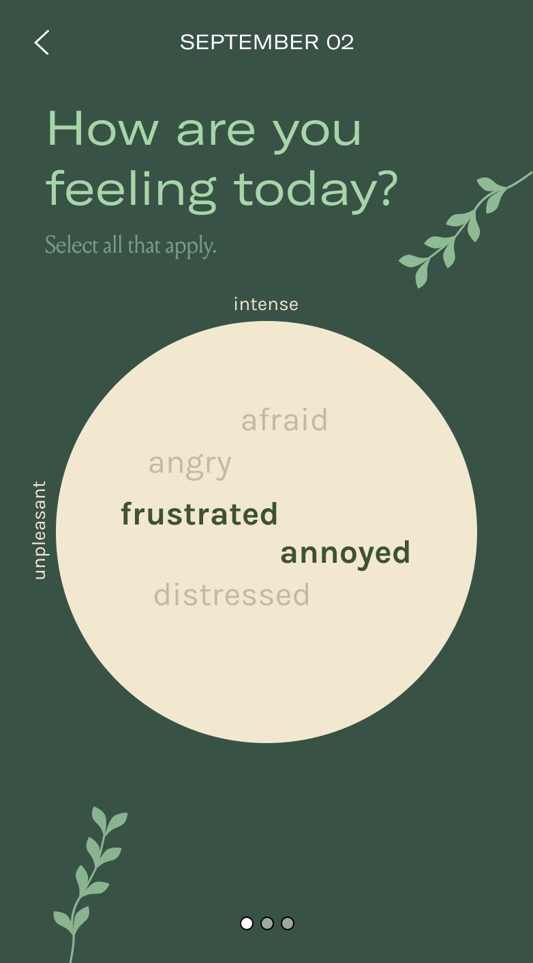
Moderate Task
Fill out a journal entry

Slide 19
Moderate Task
Fill out a journal entry

Slide 20
Moderate Task
Fill out a journal entry

Slide 21
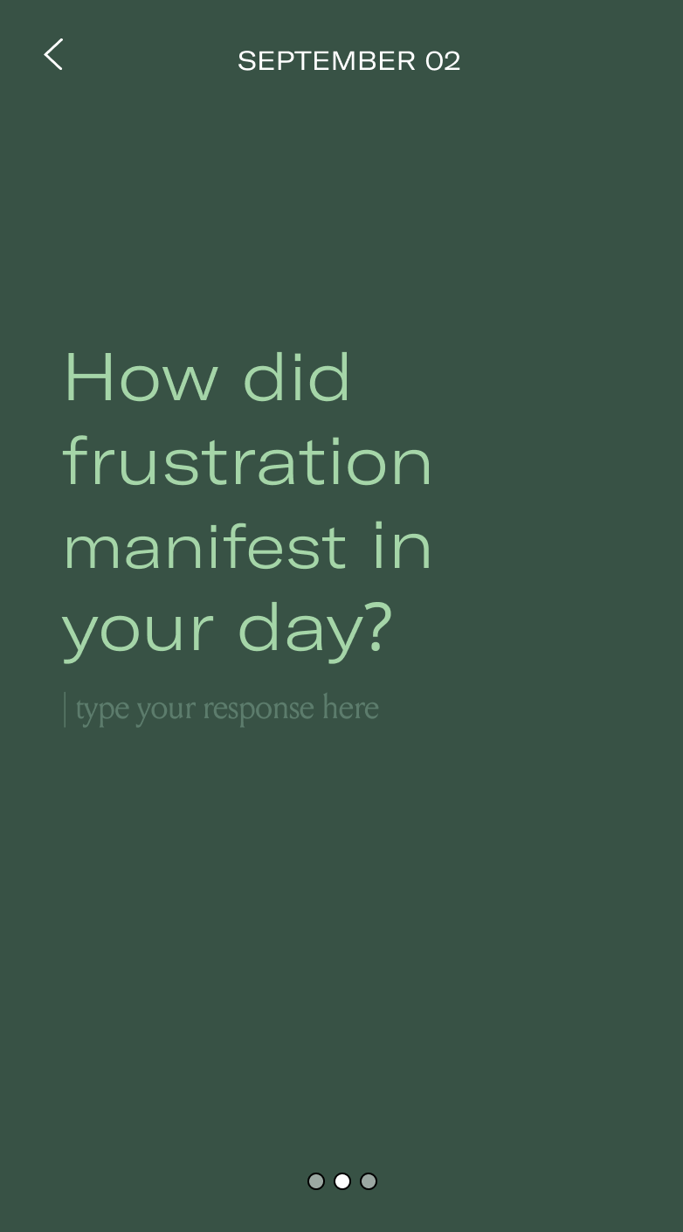
Moderate Task
Fill out a journal entry

Slide 22
Moderate Task
Fill out a journal entry

Slide 23
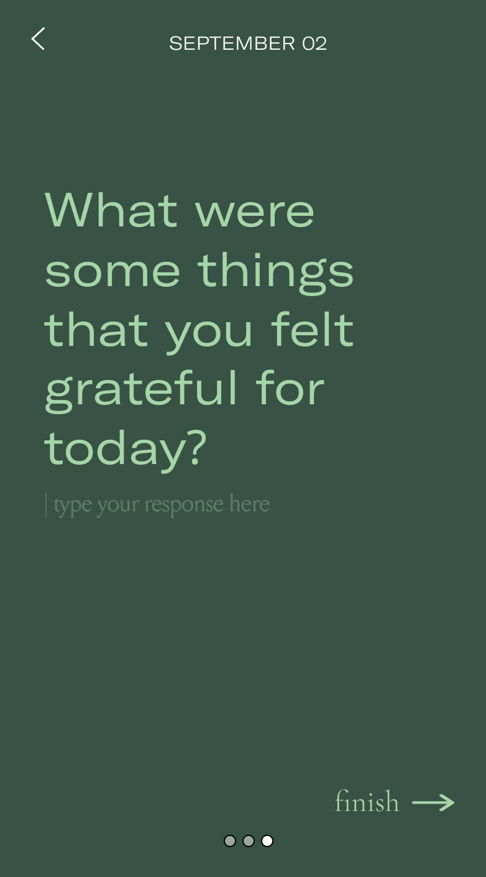
Moderate Task
Fill out a journal entry

Slide 24
Moderate Task
Fill out a journal entry

Slide 25
Moderate Task
Fill out a journal entry

Slide 26
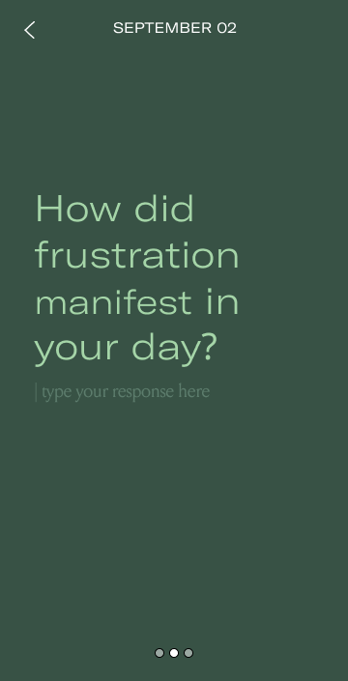

Slide 27
Complex Task
send your friend some wello wishes

Slide 28
Complex Task
send your friend some wello wishes

Slide 29
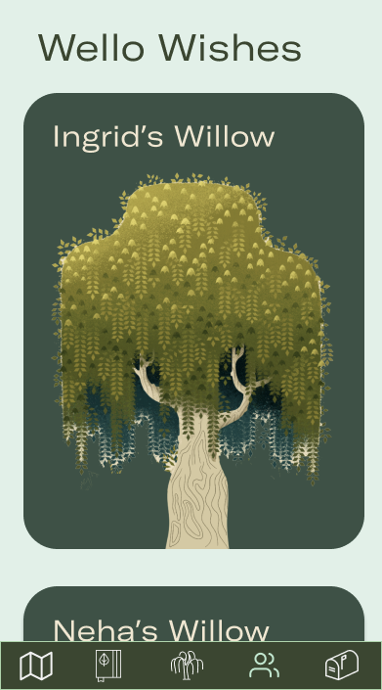
Complex Task
send your friend some wello wishes

Slide 30
Complex Task
send your friend some wello wishes

Slide 31
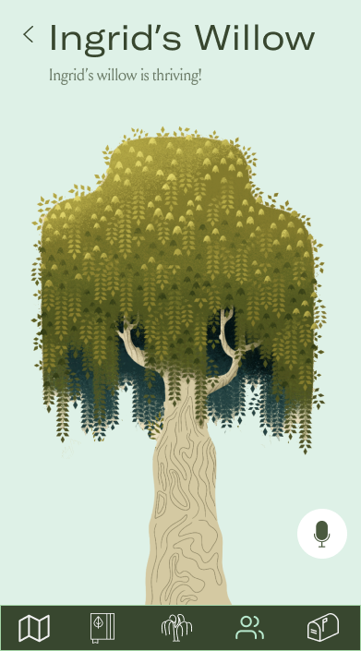
Complex Task
send your friend some wello wishes

Slide 32
Complex Task
send your friend some wello wishes

Slide 33
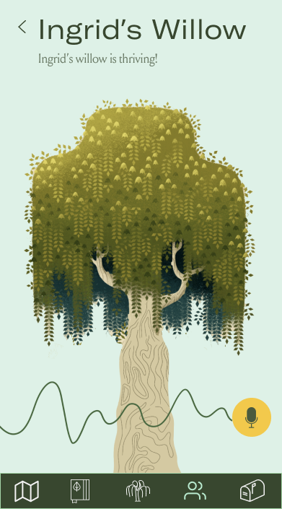
Complex Task
send your friend some wello wishes

Slide 34
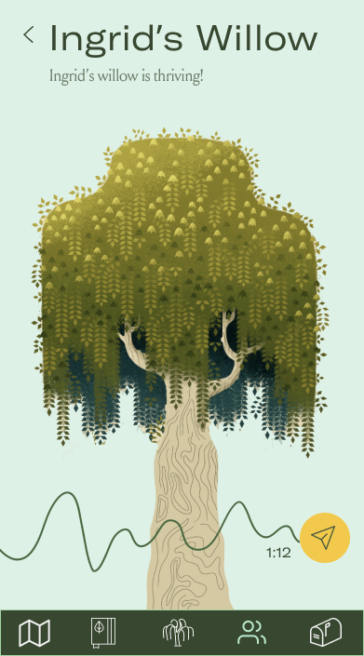
Complex Task
send your friend some wello wishes

Slide 35
Complex Task
send your friend some wello wishes

Slide 36
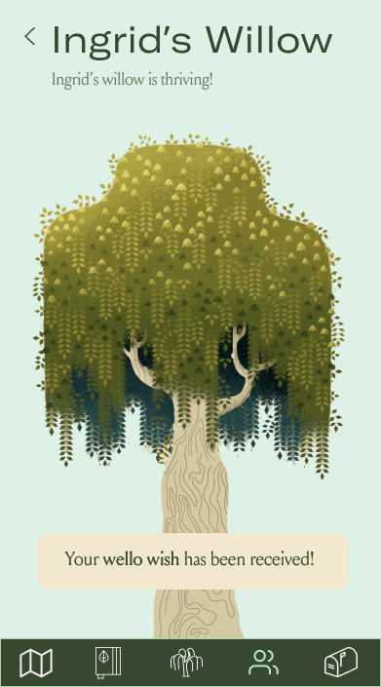
Complex Task
send your friend some wello wishes

Slide 38
Changes
From low-fi to med-fi

Slide 39
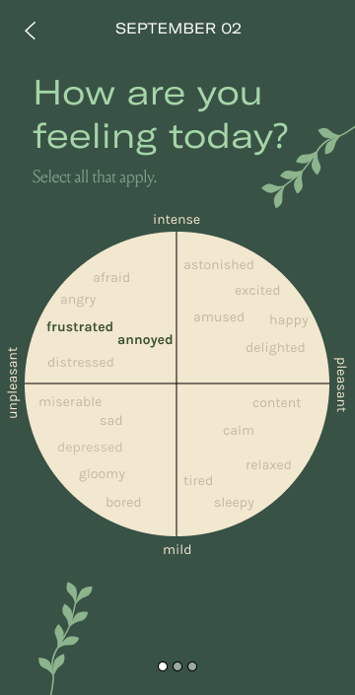
migration from emojis to valence/arousal scale
pros:
Less limited
Spatially intuitive
cons:
More visually intimidating
Requires more complicated interaction

Slide 40
migration from bouquet to a willow tree
pros:
Great opportunities for puns
Embodies strength and stability
Not as gendered as bouquets
cons:
Preconceived association between willows and melancholy

Slide 41
moving where one accesses their resources
pros:
No longer overcrowding the main visualization
More intuitive page
cons:
Requires an extra swipe-up for access

Slide 42
Tradeoffs/Limitations
Color Theme
Avoiding Lists
We wanted our app to be easy and calming to look at but still be uplifting. Thus, it was difficult choosing between a dark and light theme.
We try to avoid lists and present information in a novel format. However, this may limit intuition and accessibility.

Slide 43
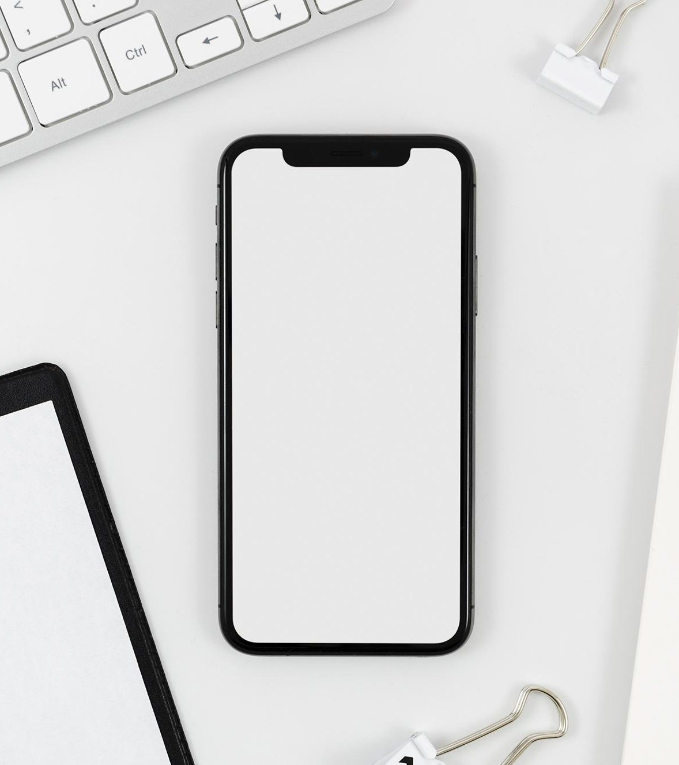
Prototyping Tools
Our Med-Fi was designed using Figma, Photoshop, Procreate, and Coolors.co, and The Noun Project
You can replace the image on the screen with your own work. Just delete this one, add yours and send it to the back

Slide 44
Thanks!
Questions? Feedback?

Slide 45
Appendix
Our Design System
Full System

Slide 46
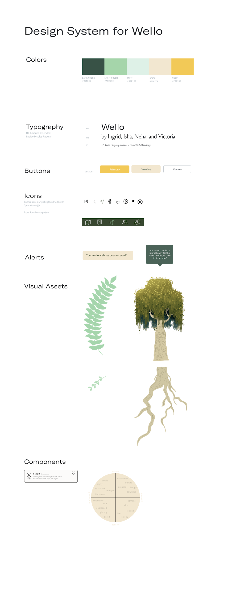
Appendix
Design Elements

Slide 47
Appendix
Colors

Slide 48
Appendix
Fonts

